Slide 1
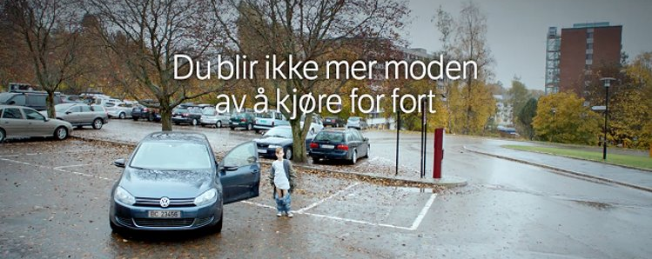
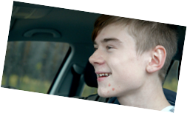
Introduction ot double penalty points for inexperienced drivers, campains and education

Slide 2
Introduction of double penalty points for inexperienced drivers
Arild Engebretsen
Senior advicer
NPRA

Slide 3
Three things that may has contributed to a reduction in injury accidents among young drivers!
Campaigns, targeting young drivers, especially boys.
Driver education
Double penalty points for novice drivers

Slide 4
the demerit point system, background and how it works.
From january 1. 2004.
Changed in 2011
  Increased number of dots.
  Increased number of violations that gives dots
  8 points in three years, loose driver licence for 6 mounths
It is the police that can give an penalty, either by stopping you or detected in an ATK(automatic traffic control)
The points are ruled out after three years from the date given.

Slide 5
Conditions that cause dots(The demerit point system)
Infringement | Number of dots
Speed limit up to 60 km/h, measured speed 10 km/h to 15 km/h above speed limit | 2
Speed limit up to 60 km/h, measured speed 16 km/h and more above speed limit | 3
Speed limit from 70 km/h measured speed 16 km/h to 20 km/h above speed limit | 2
Speed limit from 70 km/h measured speed 21 km/h and more above speed limit | 3
Don't stop for red light | 3
Illegal passing | 3
Give-way violation | 3
Driving on confined area | 3
Driving to close to the driver in front of you | 3
Driving a trimmed MC | 3
Driver has not secured passengers under the age of 15 | 2
Double points for novice drivers (2 years)
If you are caught for multiple offenses at once, you get as many dots as the offenses add up
Notification letters are sent after four dots

Slide 6
Evaluation of the demerit point system after the changes in 2011
Report; TØI 1523/2016
Analysis of media coverage of the new demerit point system
Analysis of the national demerit point register
Analysis of crash data
Questionnaires among drivers in general and drivers having incurred demerit points

Slide 7
1 Analysis of media coverage of the new demerit point system(TØI 1523/2016)
News database «Retriver»
Not suprisingly a peak in 2011
NPRA also informed on the WWW

Slide 8
2 Analysis of the national demerit point register (TØI 1523/2016)
2 797 696 persons with driving license
No «dots» in the period 1/7-2008 – 1/7-2011
Figure shows how many dots they got in period 1 and the proportion of drivers with new dots in period 2.
The result shows that the probability of additional demerit point violations decreases significantly when a driver has incurred four or more dots.
For probationary-license drivers with four or more points have a lower probability of additional points than drivers with no points.

Slide 9
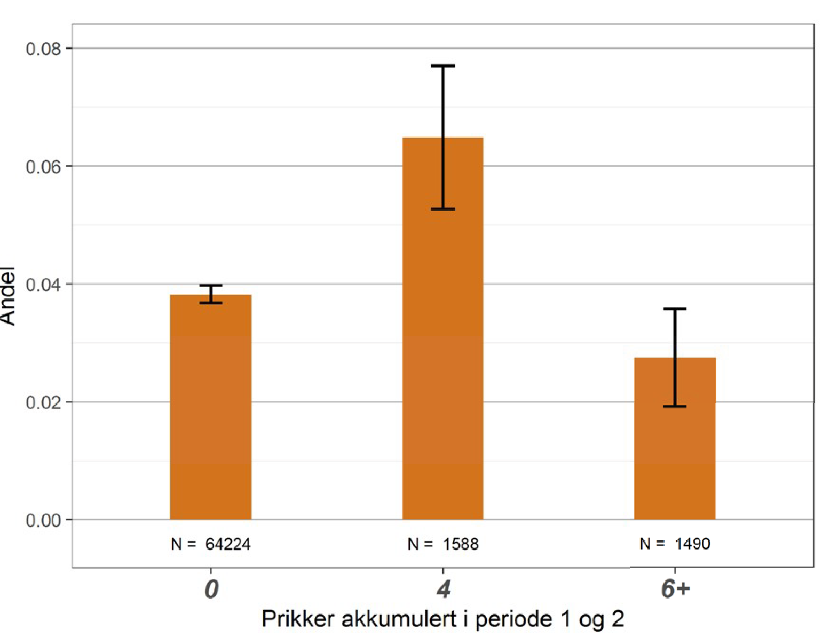
2 Analysis of the national demerit point register (TØI 1523/2016)
68191 young drivers
The figure shows the proportion of drivers in each group with new dots, grouped after number of dots they had in period 1
This result indicates that drivers that are in a position to loose their lisence, change behavior.

Slide 10
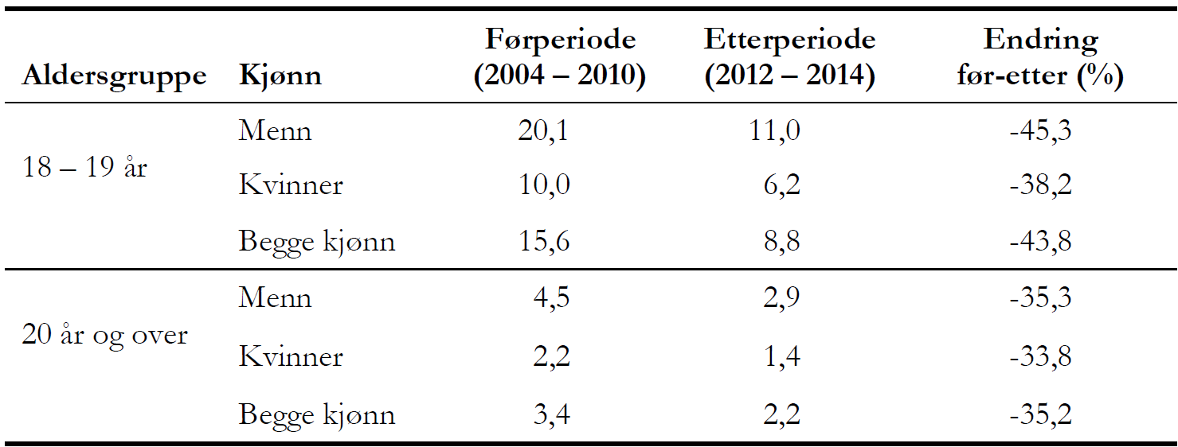
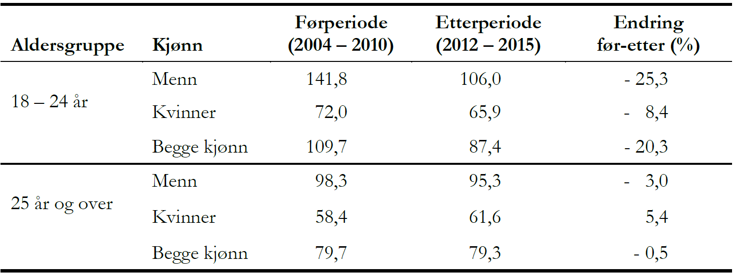
Analysis of crash data; (TØI 1523/2016)
Police reported injurie accidents
Accidents reported to Insurance companies
Result;
  The decrease in police reported crashes per license was significantly larger among 18- and 19-years old drivers than among the remaining driver population (44% vs. 35% decrease)
  The decrease in insurance reported accidents was significantly largeramong 18- and 19-years old drivers than among the remaining driver population (20% vs. 0,5% decrease)
    There may be alternative explantations but these results are consistent with a positive effect of the demerit point system, and even better results for the novice drivers.

Slide 11
Questionnaires among drivers in general and drivers having incurred demerit points
(TØI 1523/2016)
Majority of the drivers know that certain specified violations result in dots
  Few could tell the correct number of dots.
Survay confirm the results from the analysis of register data regarding the tendency thet drivers with four or more demerit points change behaviour.
Even amoung drivers without dots there is a considerable share who report that their driving is influenced by a fear of demerit points.

Slide 12

Speed campaign, 2014-2017
Target group, Boys 18-24
Goal, Make it socially unacceptable to drive too fast
  motivate people to want to change their behavior by creating an understanding of the connection between speed and risk
We used films and influencers
  It is impossible to measure the exact effect of the campain, but it was certainly not negative

Slide 13
Driver education in Norway
Experience
  The risk decreases rapidly in the first period
  Experience changes behavior
traffic skills
  It is defined as knowledge, skill, attitude and motivation
Compulsory training and quantity training
  The principle is that what we can measure on the driving test is essentially not compulsory material
Compulsory training and non-compulsory training
  Step 1 - aimed at the pupils' understanding of risk and the traffic system, mandatory
  Step 2 - learn to master the car in purely driving techniques, mandatory end of step
  Step 3 - the goals aimed at the student's learning and driving in traffic, mandatory test at end
  Step 4 - The objectives in stage 4 are mainly aimed at the students' understanding of risk and the traffic system, as in stage 1
Erfaring
Risiko
Månader med førarkort

